Slide 1


XP FARMING
FIX THE DOCS
Track 3: Industry Collaboration

Slide 2


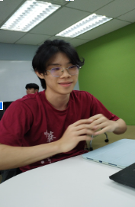
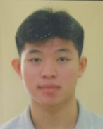
JASMINE
INTI International University
Team Members
MELODY
INTI International University
THANG QI JIAN
INTI International University
HOH WEN HAO
INTI International University

Slide 3
Problem Statement
What is the main focus on this project?
01
02
03
04
Time
Consuming
Hard to
read
Search
Issue
Visualize
Clarity Issue
Developers spend too much time writing long documentation.
Developers/users are usually lazy to read lengthy documents.
Developers hard to find needed info in the documentation.
Documentation lack of clear visuals creates confusion.

Slide 4



Main Function
Simplify Writing
Auto-generate starter docs
Users upload their project files into the system. The tool scans the codebase and automatically generates documentation.
What are the features of this function?
Category Button
Modules Relationship
Function Documentation
Tech Stack Documentation
Validation Checklist
Setup and Installation Guide

Slide 5


Main Function
Speed Up Reading
Visualize Diagram
Auto-generate flowcharts / system workflow.
Download funtion
What are the features of this function?
Export the generated documentation in multiple formats (Word / PDF).
AI Chatbot
Search, summarize, and answer questions from docs.

Slide 6




Prototype
Of Our System
START

Slide 7





Tech Stack
Frontend
AI / NLP
React (modern & nice UI)
Groq (API Key) chat box & summarize
Backend
Python FastAPI (easy AI integration)
Database
Diagram
Microsoft SQL SSMS
-Draw io (clear diagram of system flow）

Slide 8

Impact
Saves developer time
Improves code understanding
01
02
Developers spend too much time writing long documentation.
Provides a platform for developers to understand the code as they join the company.
Efficient
Reviews
Boosted Productivity
03
04
Well-documented code minimizes repeated explanations.
Engineers spend less time searching and more time coding.

Slide 9
Further Enhancement
Maintenance
01
- Detect outdated docs vs code
- Highlight the edited part and show the previous version
If the Time Permits
Privacy
02
- Provide upload by local file path and CI/CD pipeline to ensure privacy
- Provide user linked to git hub

Slide 10
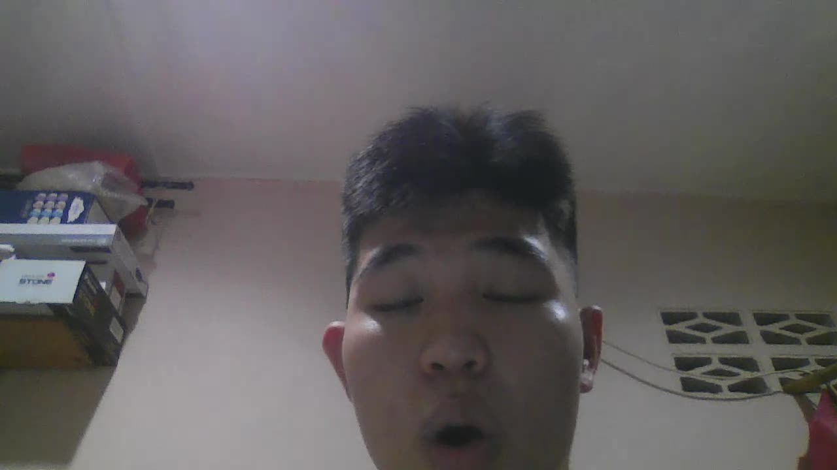
Conclusion
Clear problem statement with defined challenges.
Unique functions to help developers understand code.
Confident in building a stable solution.
Ready to move into development and make it real.

